Slide 1

Ladeside Early Learning Class
Standards and Quality Report 2025 / 2026

Slide 2
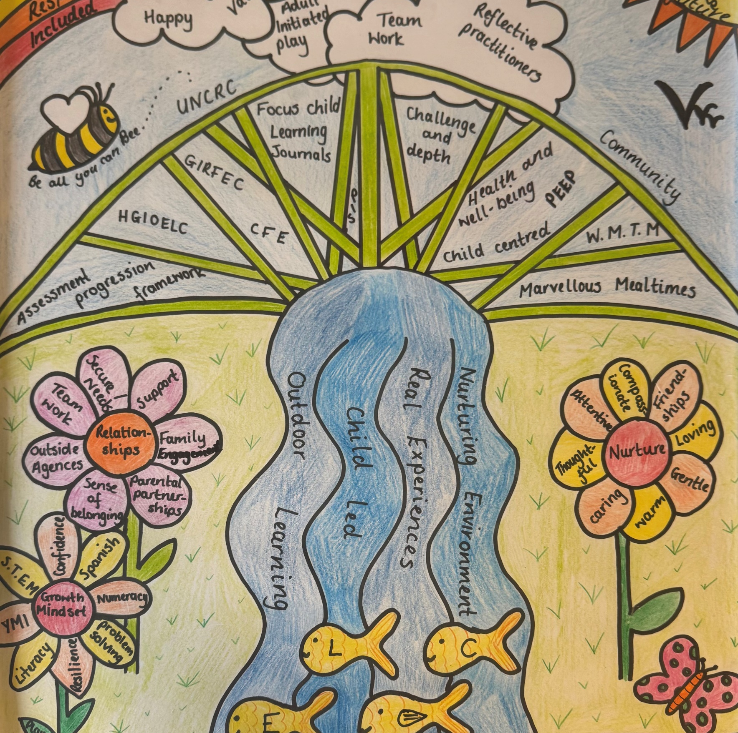
Ladeside ELC: Our Context
Ladeside ELC is a thriving part of Ladeside Primary School and ASC and is based within the community of Larbert and Stenhousemuir.
We accommodate children from age 3 under Government funding
Most of our children and families come from our local catchment area, which encompasses much of the Larbert and Stenhousemuir area.
Our day starts at 8.55am and ends at 2.55pm. We are a ‘term time only’ establishment.
We have an active parent community and work collaboratively with other agencies. We access amenities within the local area to enrich children’s learning experiences.
Ladeside ELC experienced a very positive Care Inspectorate Inspection during session 2024-25. The report can be found here https://ci-web-media-production-bucket.s3.eu-west-2.amazonaws.com/inspection-reports/CS2003015567/321129.pdf

Slide 3

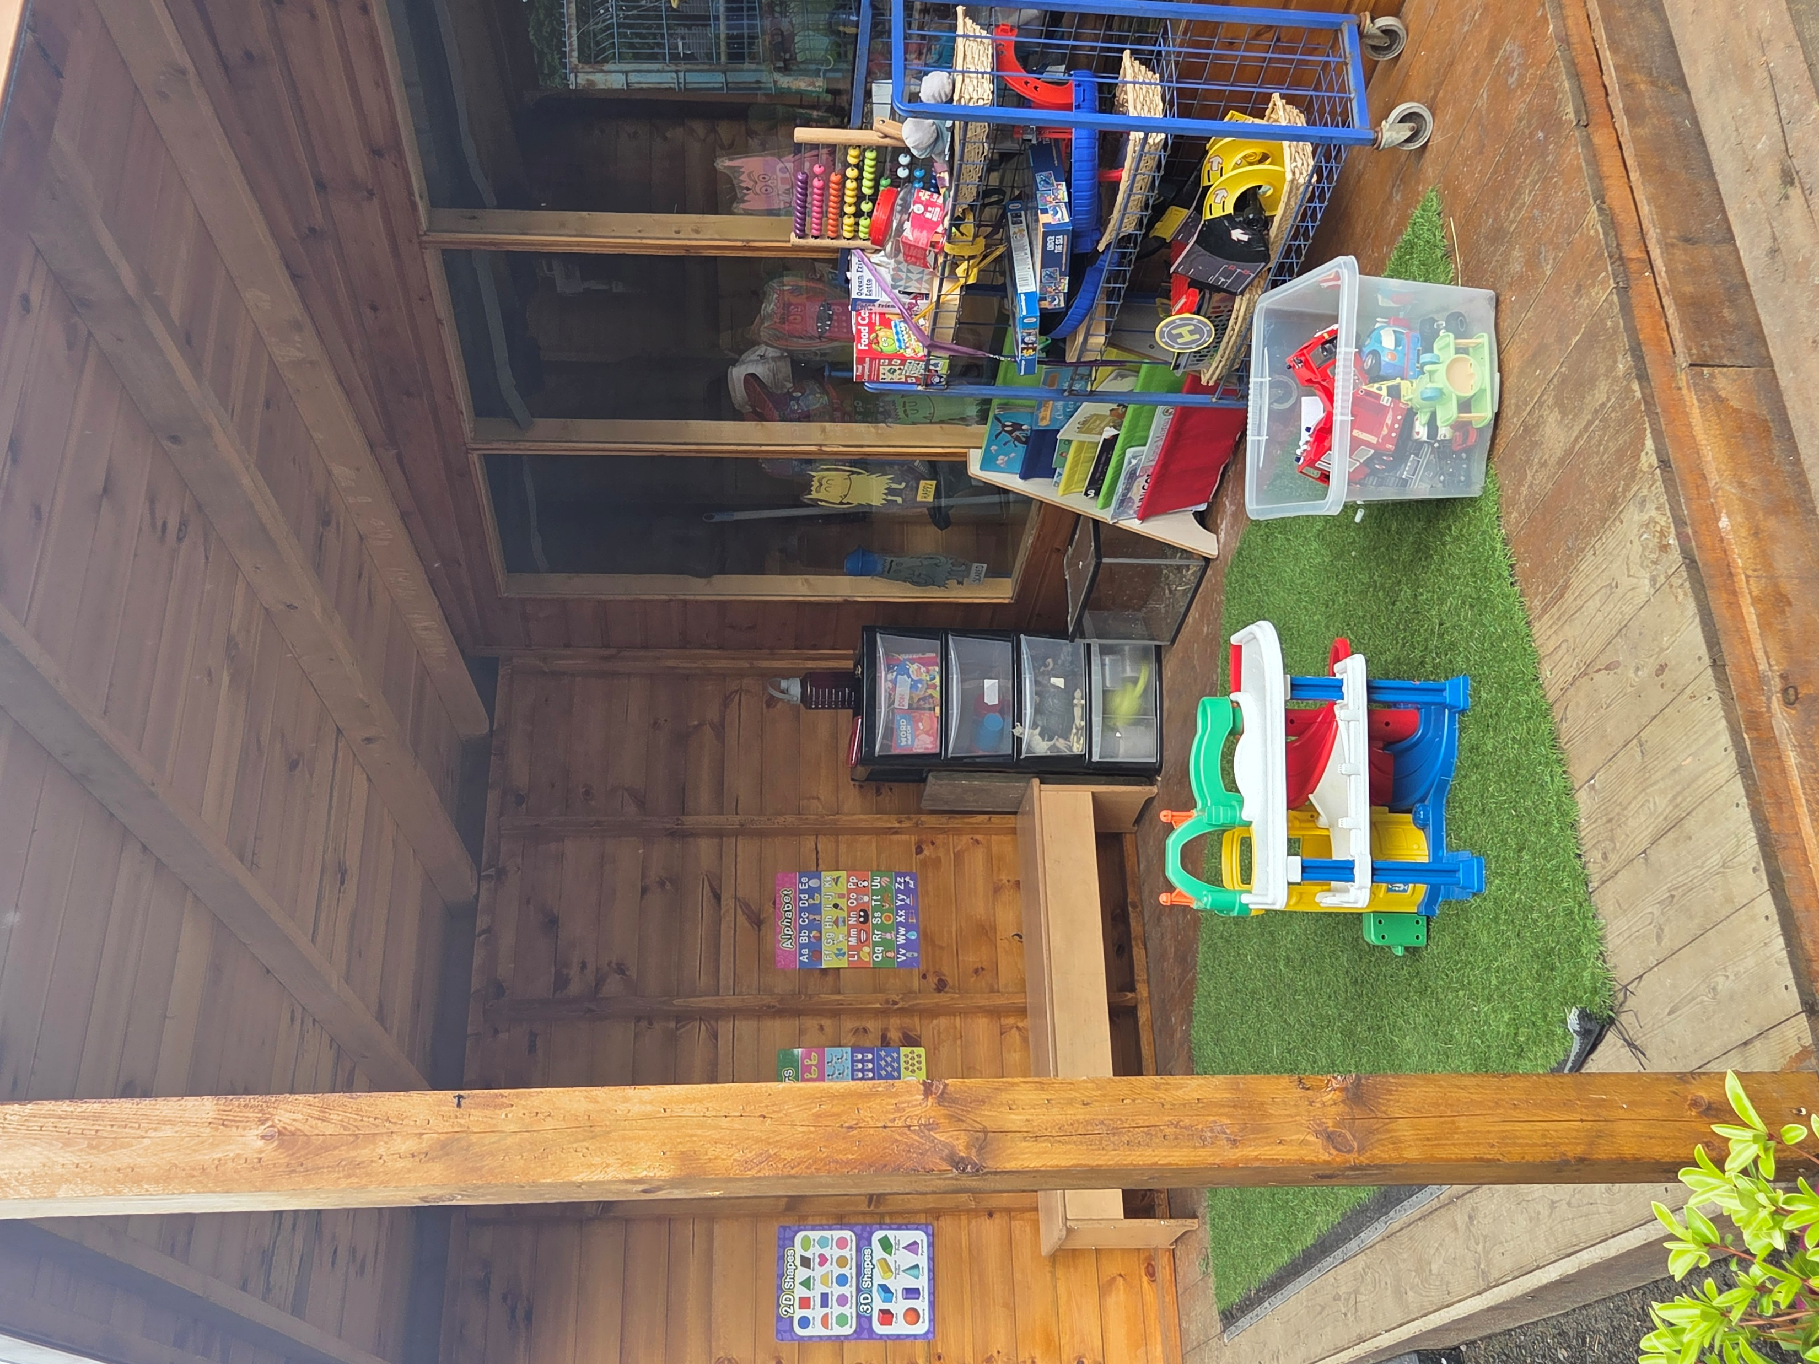
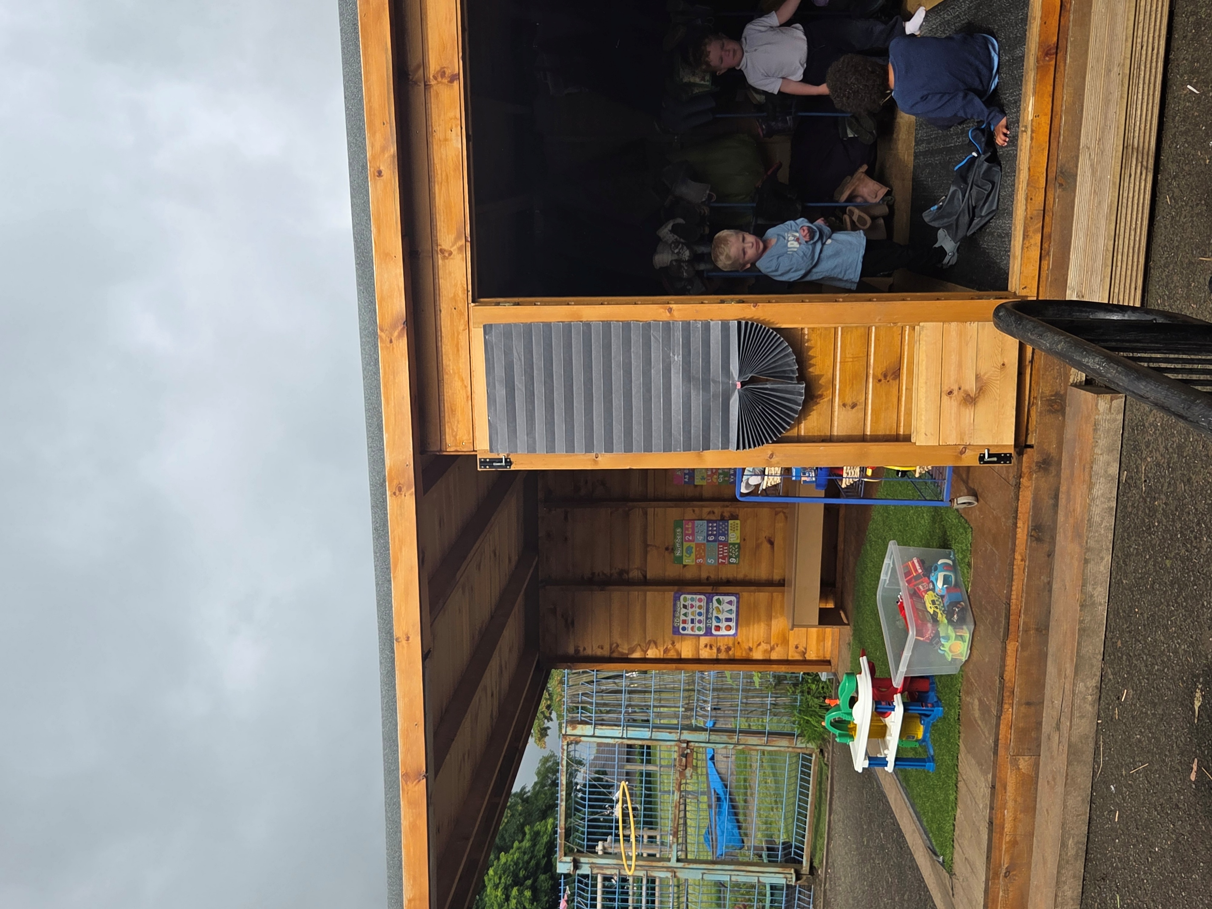
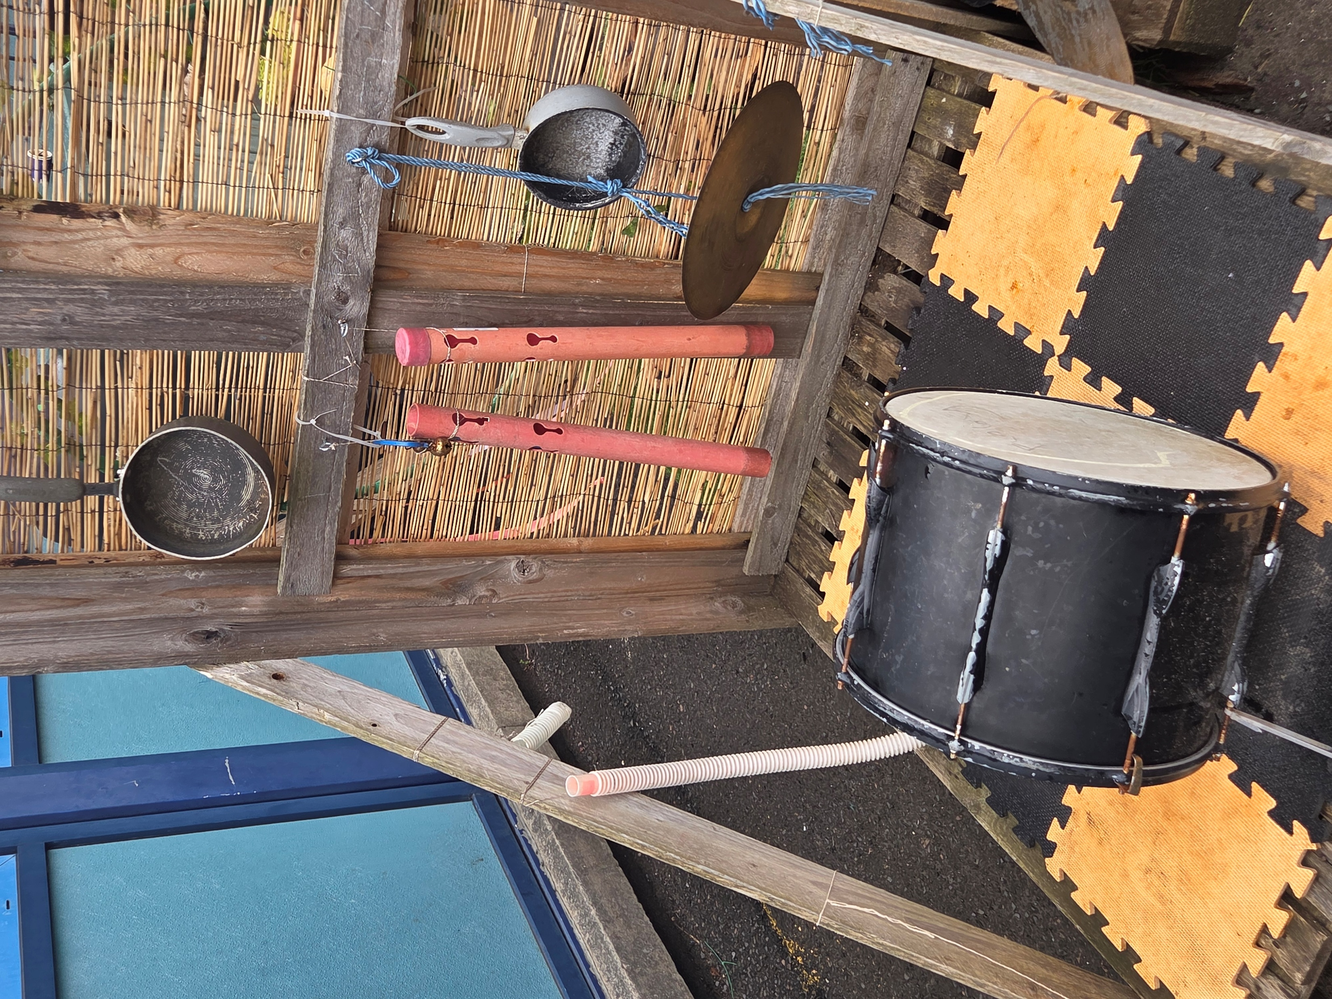
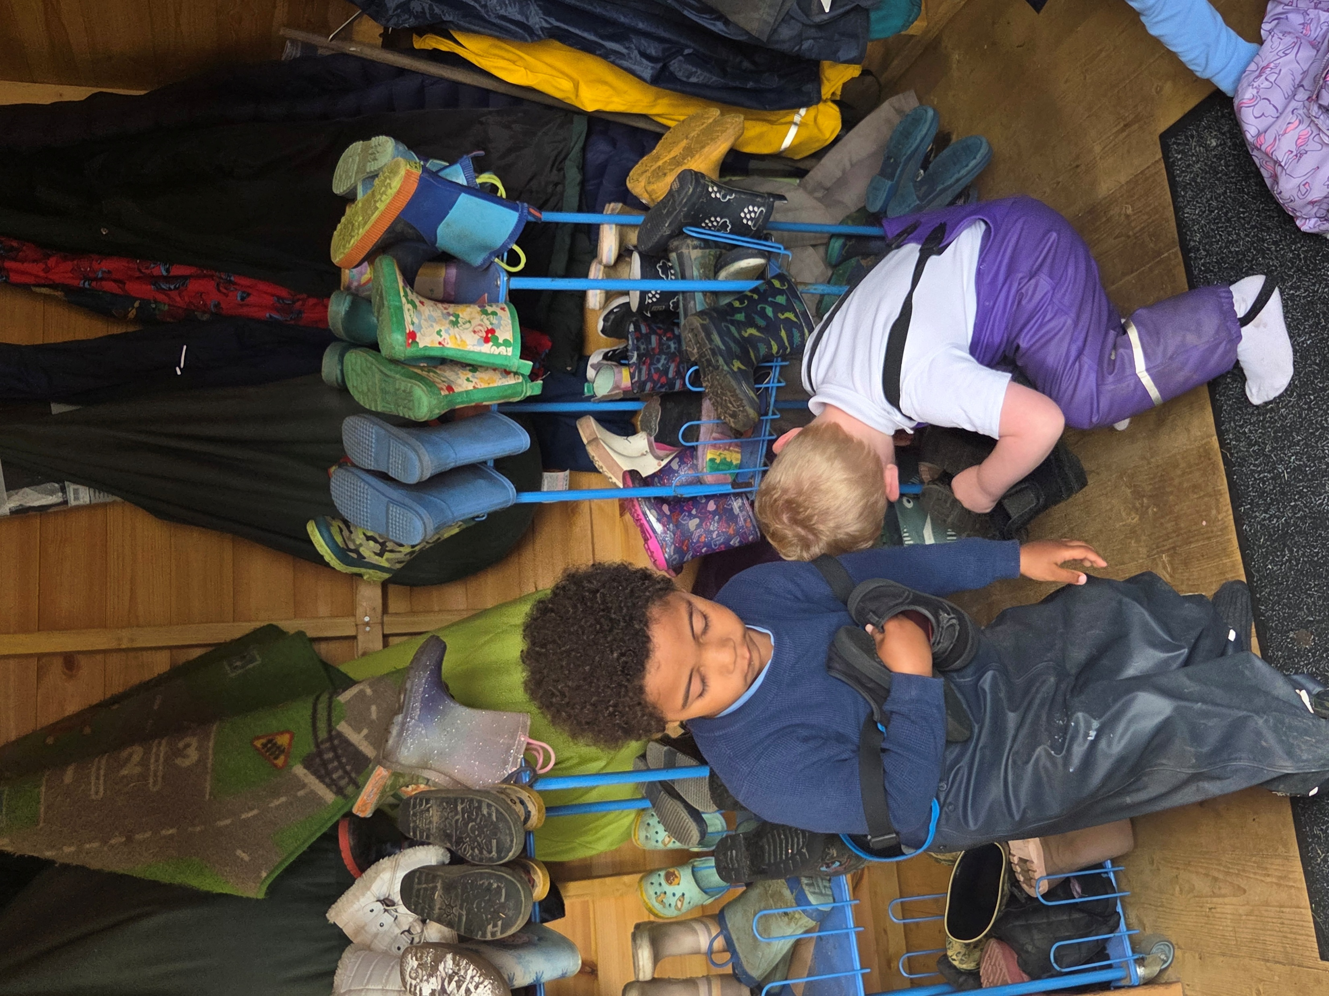
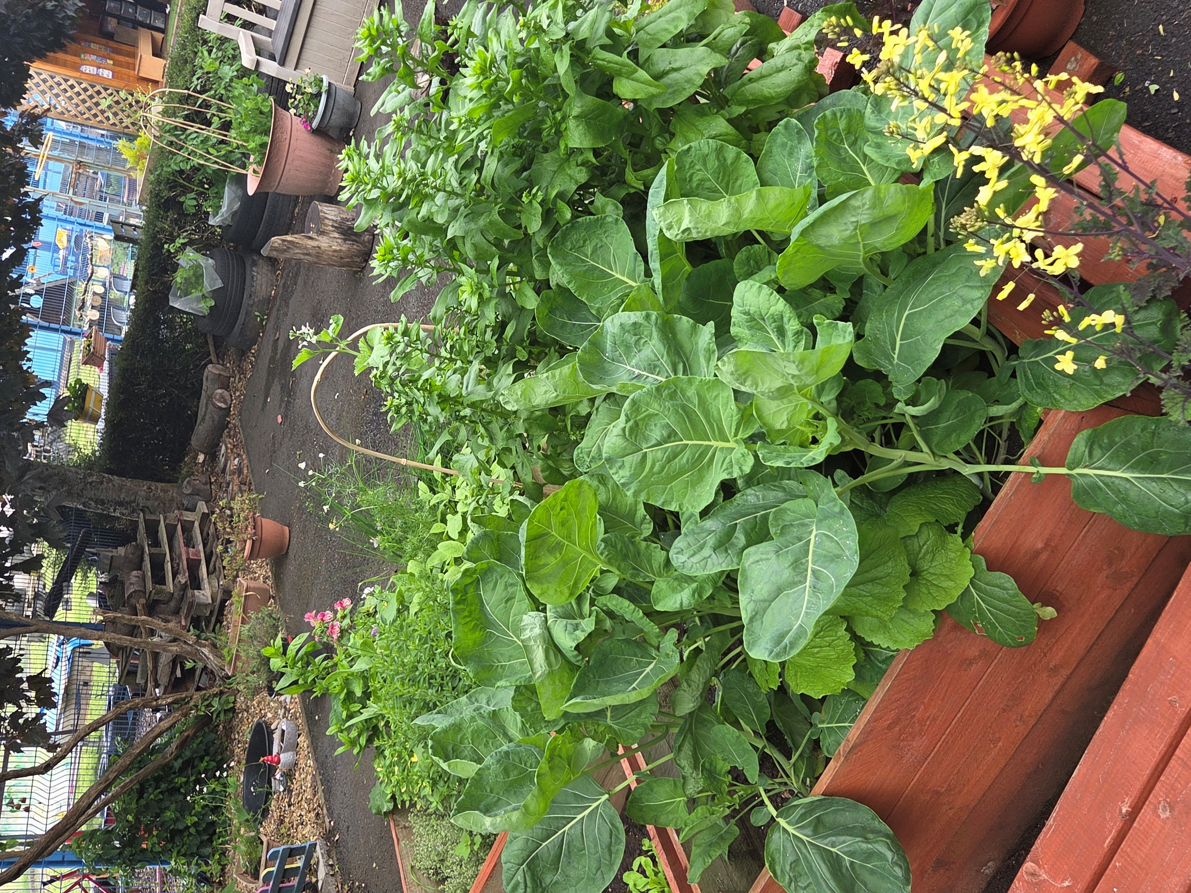
Improvement Priority 1: Outdoor Learning
What have we done:
We have added a beautiful new summer house!
It serves as a handy home for all our favourite outdoor resources including wellies and rain suits, making it easy for the children to grab what they need for an adventure.
Rain or Shine Fun: Whether it’s a sunny day where we need a bit of shade or a drizzly morning, the summer house keeps us dry and comfortable so the fun never has to stop.
A Special Place to Play: Inside, it’s becoming a favourite spot for cozy story times, quiet chats, and creative activities, giving the children a wonderful "home base" while they play outside.
We’ve created a special planting area just for the children
They have been getting their hands a little muddy, learning all about how vegetables
grow from tiny seeds into yummy snacks!
Growing Together: Watching their own veggies sprout is such a special experience. It’s helping the children learn about nature, patience, and the joy of eating healthy, home-grown food.
Our P1s have been using this area too and it has become a wonderful transition space where ELC and P1 children are working and chatting together throughout the year, making the move to P1 a smooth and enjoyable experience
We wanted our garden to be a space the children truly love, so we asked them exactly what they wanted to play with
Based on their fantastic ideas, we have added new resources including basketball nets, a music station and even a vivarium for our garden invertebrates and amphibians, that have really sparked their imaginations. It has been a joy to watch them dive into their new, child-inspired play zones with such excitement!
What did we want to improve?
Our grass area was the most popular area, with lots of hands on activities but our concrete area was less appealing for our children so we wanted to upgrade this area to provide more learning spaces
We wanted a covered outdoor area to store our wellies and waterproofs and a place for children to shelter while outdoors in any weather
We wanted to provide an outdoor area which could be used by our friends in Primary 1 as well, especially during transition activities
Moving Forwards:
We want to add a soft ground covering to our concrete area to increase the independence and confidence of our little learners.
We want to continue to develop or planting area to make it a source of food for our ELC all year round. This will allow us to develop our pantry options for lunch and snack while increasing children’s awareness of where their food comes from.

Slide 4
Improvement Priority 2: Effective partnerships
We have increased the number of PEEPs sessions this year and we have invited other agencies to come along in line with family requests
What have we done?
Learning Together Through PEEPs
We have loved hosting our PEEPs (Parents Early Education Partnership) sessions. These have been a fantastic way for us to share tips, learn from one another, and grow as a community.
Our focus has been on topics that matter most to you, including : Speech and Language, sharing fun games and everyday activities to boost communication skills, exploring gentle ways to help our little ones understand and manage their feelings, hands-on sessions involving easy meal preparation, sleep routines and some crafting
Community Visits
Our little explorers have been busy visiting local shops to learn about our neighborhood, spending time in our parks to connect with nature, and making special trips to local care homes to share songs and smiles with our older neighbours.
Family Involvement
We have loved seeing so many of you join us for:
Stay and Play: Precious time for you to see your child in their element and meet other nursery families.
Focus Child Breakfast & Afternoon Tea: Our "Focus Child" sessions have been a huge hit, giving you a chance to share a relaxed meal and chat about your child’s learning journey.
Reading Sessions: Getting lost in stories together is one of our favorite ways to settle in and share a quiet moment.
Seasonal Celebrations: From our Spring Fling to dedicated days for planting and crafting, these events have truly brought our nursery community to life.
What did we want to improve?
We wanted to provide our families with more opportunities to come into Nursery and really get to know our staff and our spaces and see their children thrive within our setting.
We wanted to give our children opportunities to meet our community through visits to local places.
We wanted to provide support for our families in different ways.
80% of our families have attended a Focus breakfast or afternoon tea
98% of our families have been able to attend two or more events / sessions within our ELC this year
Moving Forwards:
PEEPs will continue next session with our new families.
We will be expanding our community links to include our friends in other care homes and Age Concern.

Slide 5
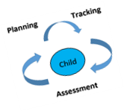
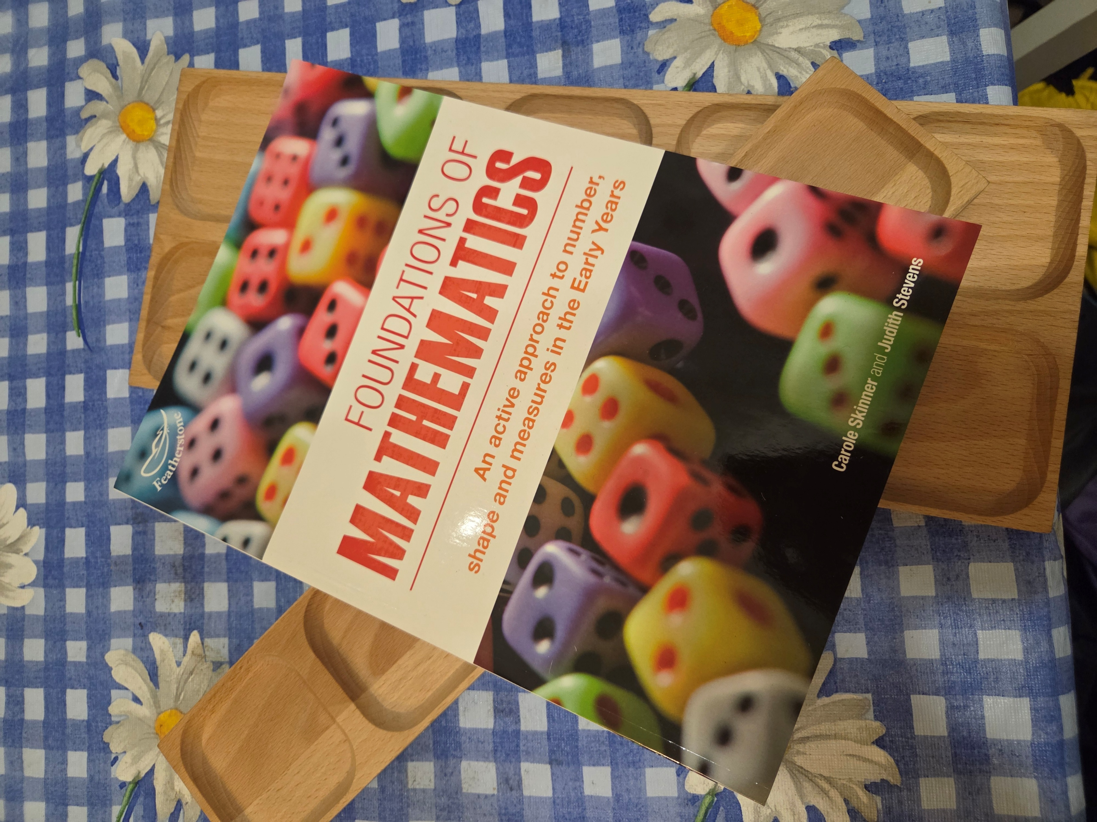
Improvement Priority 3:Tracking and Recording progress
Clear progression can be seen in our data in both language and maths from last session.
What did we want to improve?
We wanted to ensure that all staff were involved in the learning of every child within the ELC
We wanted to embed the Council Assessment Framework into our Focus Child cycles
We wanted to make each child’s learning and progression visible to families
What have we done:
We have embedded the Falkirk Council Assessment Framework within the ELC, with all staff contributing to ongoing monitoring and assessment in all curricular areas
All staff attended ‘Early Maths’ training, focussing on holistic approaches to assessing maths
All children have participated in the Focus Child cycle where every member of staff is involved in observing and assessing progress
We have added ‘next steps’ to each child’s Focus Book – making progression visible to families
Almost all staff have completed the Falkirk Council SMART Target training to improve our ability to set achievable and progressive targets for all of our learners who benefit from targeted interventions
Our data shows us that we could improve our phonological awareness experiences for our learners
Moving Forwards:
We want to ensure that our spaces continue to provide challenge and depth for our learners, particularly those in their additional year
We will be taking forward training in ‘listening skills’ as a whole staff to help to further improve phonological awareness within the ELC.

